Slide 1
Introduction to Alchemy API
September 22, 2015

Slide 2
Who is AlchemyAPI?
Pioneer of web services for real-time text and image analysis
Founded in 2005
60,000+ developers
Used in 36+ countries
> 1.5 Billion calls a month
Acquired by IBM Watson
Democratizing artificial intelligence
Notes:
At AlchemyAPI, we believe we’re entering a new age of artificial intelligence where computers can understand human language and vision at a complex level. These breakthroughs are probably why many of you are on the call today.
We want to make these advancements widely available, affordable and easy-to-use so that everyone can benefit from their creation. That’s why we are building a cloud platform and leading a community where developers create applications that achieve new insights and capabilities.
Our passion is making advanced text and vision analytics easily available through REST APIs that allow anyone with a little programming skill to create applications that route corporate communications based on their content, trend topics across news and blogs, extract customer preferences from social media posts or make recommendations matching reader’s interests.

Slide 3
What can Alchemy do for you?
Quickly extract meaningful information from unstructured data
Categorize and label text and images
Analyze sentiment
Connect your data to additional knowledge sources
Notes:
Use AlchemyLanguage to quantify sentiment and extract entity information
Stock tracking idea (find a statement about a company, for example)

Slide 4
To get started you can…
Get an API Key
Download an SDK
Check out the Getting Started Guides
Ask me questions!
Notes:
Let’s get started with AlchemyAPI

Slide 5
The most popular APIs
AlchemyLanguage
Named Entity Extraction
Sentiment Analysis
Keyword Extraction
Relations Extraction
Taxonomy
AlchemyVision
Image Tagging
Face Recognition
AlchemyData News
News

Slide 6
Making API Calls
RESTful APIs for understanding data from text, URLs, images, etc.
Endpoints available in API documentation
http://access.alchemyapi.com/calls/text/TextGetRankedNamedEntities
Required and optional parameters
?apikey=<YOUR API KEY>&text=IBM Watson&outputMode=json
Full URL
http://access.alchemyapi.com/calls/text/TextGetRankedNamedEntities?apikey=<YOUR API KEY>&text=IBM Watson&outputMode=json
Notes:
Use AlchemyLanguage to quantify sentiment and extract entity information
Stock tracking idea (find a statement about a company, for example)

Slide 7
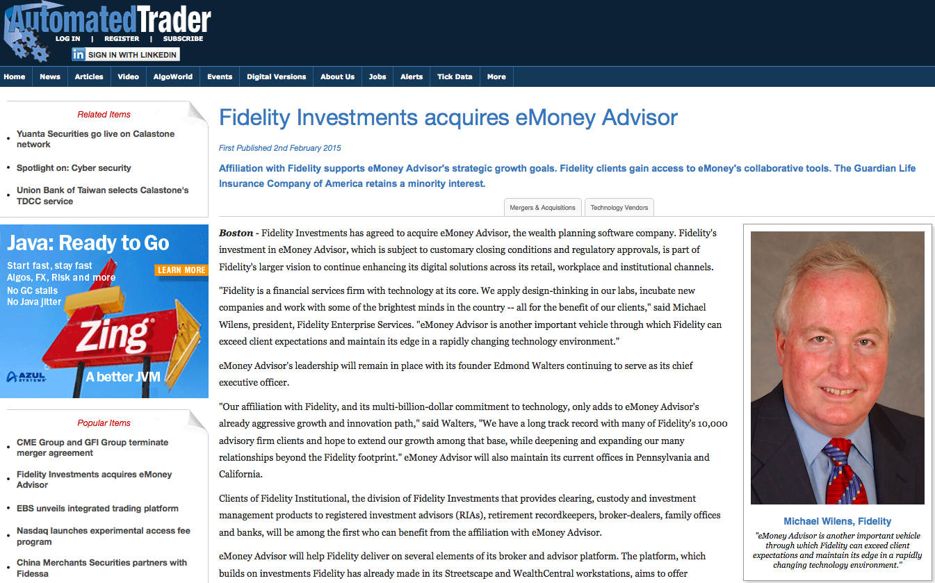
Named Entity Extraction
See all
entity types
Extract people, places, organizations, etc. from blogs, news articles and other text.
Examples:
President Obama works at the White House. View Results
Zach Walchuk was born in Mankato, MN and lives in the white house down the street. View Results
View Results

Slide 8
Sentiment Analysis
Extract positive and negative opinions from any text.
Document-level, entity-targeted, and keyword-targeted sentiment mining.
Understands negations, amplifiers, diminishers, typos, hashtags and slang.
Examples:
Overall Text Sentiment
So happy the Patriots won the Super Bowl. Let's party. #PatriotsParade View Results
Targeted Sentiment
So happy the Patriots won the Super Bowl Seahawks suck. #BradyBunch View Results Sea View Results Pats
Run on entities/keywords, if you do not have a specific target in mind.
Overall Text Sentiment
So happy the Patriots won the Super Bowl Seahawks suck. View Results

Slide 9
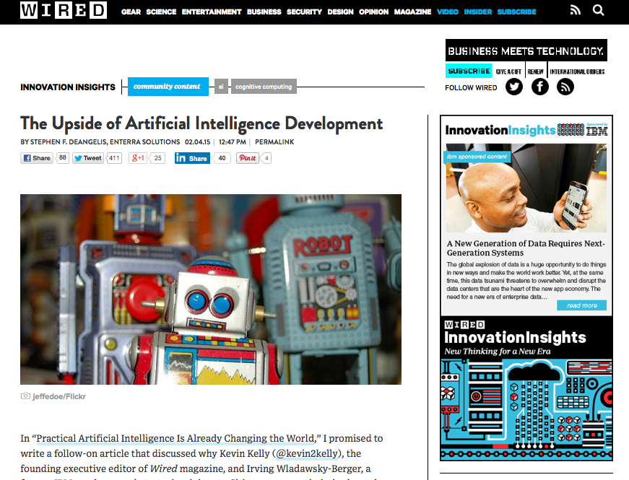
Keyword Extraction
Extract topic keywords, with higher level abstractions via Knowledge Graph.
Examples:
The New England Patriots raised the Lombardi Trophy over the city of Boston on Wednesday. View Results
Keyword extraction is like making a “word cloud” of important words in your document.
View Results

Slide 10
Relations Extraction
Extract the facts you need from raw text.
Identifies Subject > Verb > Object
Examples:
Article Title: I want a sandwich View Results
Article Title: Charter buys Bright House View Results
“I” ➔ “want” ➔ “sandwich”
“Charter” ➔ “buys” ➔ “Bright House”

Slide 11

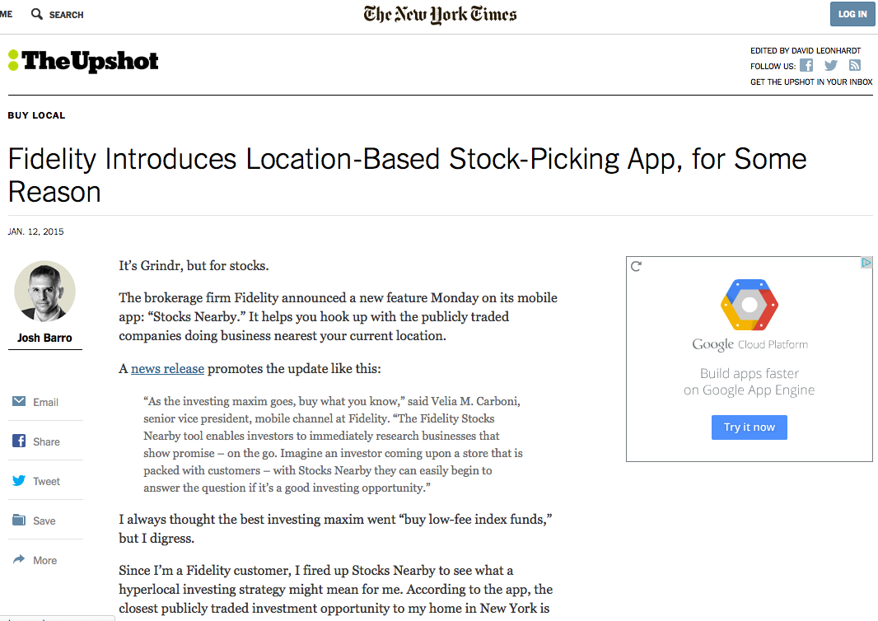
Taxonomy
Classify text documents based on 1000+ categories and subcategories.
Examples:
Lebron James has been struggling lately in his recent return to the Cavs. View Results
View Results
View Results

Slide 12
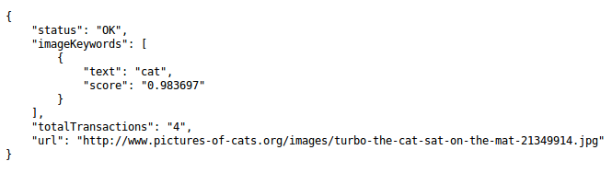

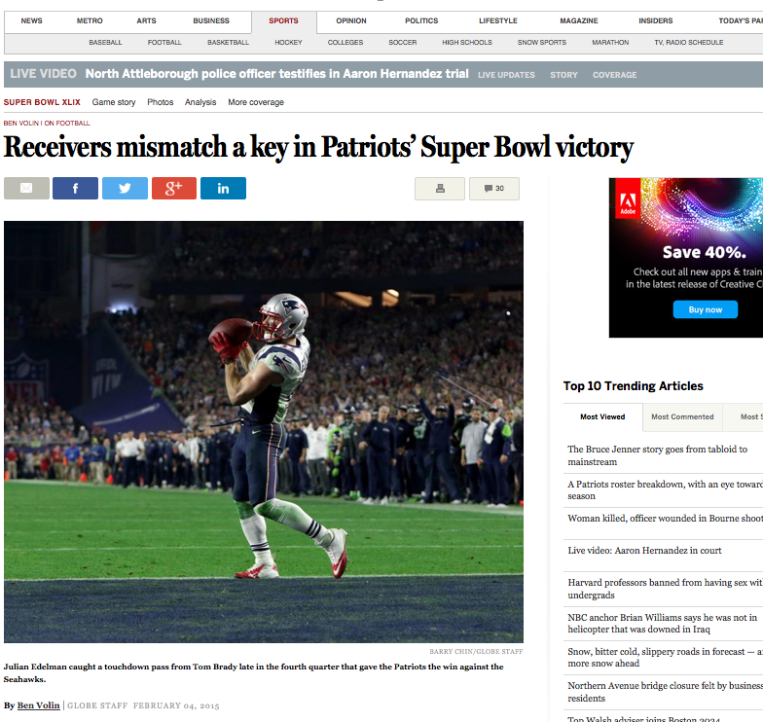
Image Tagging
Extract keywords to categorize your image libraries.
Examples:
View Results

Slide 13

Face Detection
Gather intelligence from images and tag photos with the position, age, gender, and identities of people photos.
Examples:
View Results

Slide 14
AlchemyAPI in the Application Stack
News Search API
Bing
Data Store
MongoDB
Messaging API
Twilio
Natural Language Processing API
AlchemyAPI
Crawl the web with a Search API to find news articles relevant to your interests.
Add intelligence and value with an NLP API. Filter search results to include specific actions (‘acquired’, ‘bought’, ‘sold’, etc.), or categorize the articles in a taxonomy.
Store your enhanced search results in a database to access and analyze later.
Send text alerts based on keywords, actions or trends found in your news article collection.

Slide 15
AlchemyData News
Query pre-enriched news articles to find trends, monitor events, and get up to date information
Documentation
Query builder with examples
Sample application – Who's in the News
Webinar:
3 Ways to Enhance Your Product With Cognitive News

Slide 16
How others have used AlchemyAPI
Others have utilized AlchemyAPI to create enhanced solutions
Watson News Explorer
Blog Post
Actual Application
TED Talks Query Engine
Blog Post
Actual Application

Slide 17
Backup

Slide 18




Alchemy’s Platform: Transforming Data Into Value
The world’s unstructured data
Acquired and cleaned seamlessly
Stored and enriched with AlchemyAI
Accessed via simple REST APIs
For Smart Apps and Services
AlchemyData®
Semantic Data Store
Public Web and Social
Your Private Text and Messages
API
Smart Apps
AlchemyLanguage® AlchemyVision®
Data Partners
Alchemy’s platform eliminates friction when extracting business value from unstructured data
Notes:
Only Full Stack AI for unstructured data analysis apps
Only public cloud platform that understands Text and Images
Only public cloud platform that processes billions of docs/month

Slide 19

Reducing Friction for Developers
Service Accessibility
Service is testable via Browser’s URL bar
Easy API keys, no complex authentication
One key works across all services
Common API parameters across all services
All services return consistent XML and JSON
Responses are easy to parse and understand
Real-time usage tracking / API limits adjustment
Notes:
Only Full Stack AI for unstructured data analysis apps
Only public cloud platform that understands Text and Images
Only public cloud platform that processes billions of docs/month

Slide 20

Reducing Friction for Developers
Making It Easy
Only platform to integrate real-time crawling
Automatic content type detection
Automatic language detection
Automatic content cleaning
Steerable page content extraction
URL -> Metadata – no training, models, or anything
Automatic entity linking + enrichment
Individual + “Combined” API calls
Notes:
Only Full Stack AI for unstructured data analysis apps
Only public cloud platform that understands Text and Images
Only public cloud platform that processes billions of docs/month

Slide 21

Reducing Friction for Developers
Combinatorial Effect
Dozens of enrichment functions
Combining functions enables new use cases:
Authorship + Entity + Sentiment = PR Targeting
More than any single algorithm
Drives customer retention
Integrated data storage + analytics
AlchemyData Buckets
Only full-stack solution
NLP+Vision+Analytics
Only real-time solution
Crawling+Cleaning+Enrichment
Notes:
Only Full Stack AI for unstructured data analysis apps
Only public cloud platform that understands Text and Images
Only public cloud platform that processes billions of docs/month

Slide 22
Entity Extraction
AlchemyAPI Language
Named entities specify things such as persons, places and organizations. AlchemyAPI's named entity extraction is capable of identifying people, companies, organizations, cities, geographic features and other typed entities from your HTML, text or web-based content.
Identifies named entities within subjects and objects of identified Subject-Action-Object relations, supporting advanced entity recognition capabilities including disambiguation, core-reference resolution and linked data output.
Adds a wealth of semantic knowledge to your content to help you quickly understand the subject of the text.
One of the most common starting points for using natural language processing techniques to enrich your content
Retrieves a grouped, relevancy-ranked list of all named entities occurring within an HTML or text document
* Linked Support Data
Add a wealth of semantic knowledge to your content
Quickly understand the subject of the text
One of the most common starting points for NLP
Contextual Advertising - Taboola uses our Entity Extraction and Concept Extraction APIs to have a contextual understanding of a URL. Based on that contextual understanding of the page this information is fed into the Taboola recommendation engine to place the most relevant piece of native advertising for the user.
Spiderbook – CRM
Waggener Edstrom – Public Relations
Pocket – Content Discovery
CEBRA – Public Health and Safety
Identifying persons, companies, places and things in text is important
To understanding the context of a piece of text whether it’s a customer service email an internal document or an article on the web talking about your competition.

Slide 23
Sentiment Analysis “Voice of the Customer”
AlchemyAPI Language
Sentiment is the attitude, opinion or feeling toward something, such as a person, organization, product or location
Provides easy-to-use mechanisms to identify the positive or negative sentiment within any document or webpage.
Capable of computing document-level sentiment, sentiment for a user-specified target, entity-level sentiment, quotation-level sentiment, directional-sentiment and keyword-level sentiment (enables social media monitoring)
Adds a wealth of semantic knowledge to your content to help you quickly understand the subject of the text.
One of the most common starting points for using natural language processing techniques to enrich your content
Retrieves a grouped, relevancy-ranked list of all named entities occurring within an HTML or text document
Understanding customers
Trend Analysis
Social Media monitoring
Consulting – Prior to using our Sentiment Analysis service Gallup was hiring a small army of temporary employees to manually read and score hundreds of thousands of customer survey responses for their customers. This process regularly took up to several months and was quite expensive due to its manual nature. Simply put, this process doesn't scale. Upon evaluating Alchemy's Sentiment Analysis tool they found that it was close to 80% accurate. The processing time to apply a Sentiment score to went from months to days with Alchemy's service. With mountains of data located in CRMs, Email, Chat, Social Media and voice conversations that are then transcribed to text the sources of customer feedback are many and the amount is vast and overwhelming for most enterprises.
Pulsar – Marketing
AdTheorent – Advertising
How well is your organization understanding the voice of your customers? Today’s consumers are using Social Media, Email, Text Message, Blogs, Community Forums, Customer Service Chats and telephone conversations to voice their opinion. All of this is unstructured data with valuable insights waiting to be extracted so you can act on them in real-time.

Slide 24
Keyword Extraction
AlchemyAPI Language
Keywords are the important topics in your content and can be used to index data, generate tag clouds or for searching.
Capable of finding keywords in text and ranking them– a relevance score based on statistical analysis.
Determines the negative or positive sentiment associated with each identified keyword.
Employs sophisticated statistical algorithms and natural language processing technology to analyze your content and identify the relevant keywords.
Supported in over a half-dozen different languages, enabling even foreign-language content to be categorized and tagged.
Works on URLs, HTML documents and plain text.
Automatically detects the language of the content and then performs the appropriate analysis.
Index data
Generate tag clouds
Searching
Tax –Intuit company had 20M documents that were primarily User Generated Content or "UGC". The story around this use case is not knowing what assets an enterprise has for either internal search or SEO enhancement for public search.
Market research - Consumers reveal their preferences for products or services based on their browsing behavior and in online dialogues (downloading and reading content, search history, topics pursued in social channels etc.) Finding the actionable information in the “noise” and volume of data. Identify conceptual relationships. Using Keyword Extraction and Relation Extraction API calls from AlchemyAPI consumer intent is far more accurately determined than traditional methods such as Surveys and focus groups.
Voice of the Customer / Customer Satisfaction– Use Alchemy’s Keyword Sentiment Analysis to identify which keywords in a document have negative sentiment associated with them. We ran 5,000 app reviews on the consumer app Mint by Intuit and found keywords with negative sentiment to be a strong signal for ways the app developers could improve the application.
Pulsar - Marketing
Spiderbook - CRM
Waggener Edstrom – Public Relations
AdTheorent – Advertising
Triberr - Publishing
CrisisNET – Crisis Data Platform
BrainJuicer – Market Research
Similar to Entity Extraction, identifying keywords in text is important to understanding the context of a piece of text whether it’s a customer service email an internal document or an article on the web talking about your competition.

Slide 25

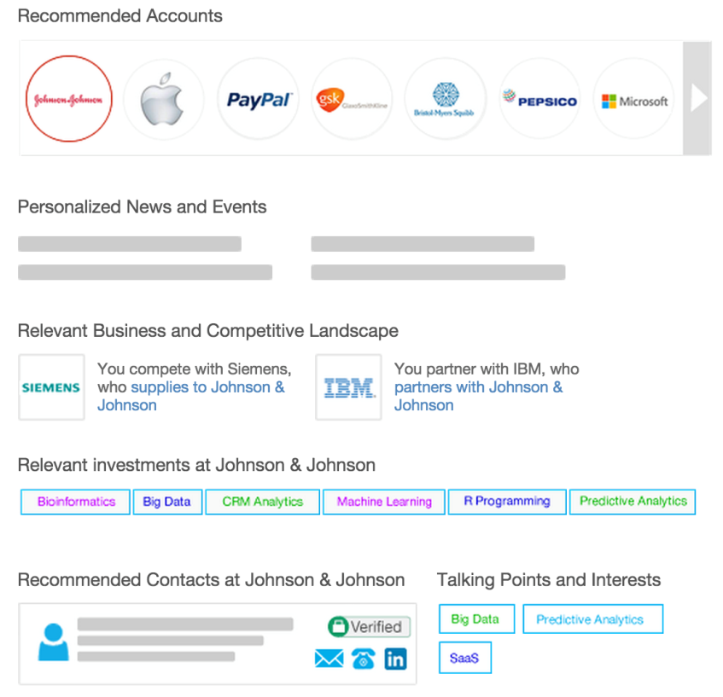
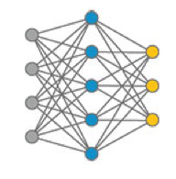

Spiderbook – CRM
AlchemyAPI Use Cases
What it is:
ROI
AlchemyAPIs Used
Challenge: processing all of the content available to provide deal-closing business intelligence.
Go beyond traditional CRM by using NLP and entity recognition– Empowering sales teams to close more deals by predicting prospect behavior
Analyzes: 1,000+ photos / day, 40,000 users interacting with site daily, 100,000+ registered restaurants
Types: public online data (website content, PR< marketing materials, social media, SEC filings, LinkedIn, SlideShare), business profiles through partnerships with data services providers
Solution: a predictive customer relationship discovery app that mines the entire Web
Creates 10x more accurate customer relationship predictor using AlchemyAPI
Value: speed is great, accuracy is paramount – AlchemyAPI delivers both
Outperformed its closest competitor by 20-30%
Results: SpiderGraph (unique business intelligence service), exponential user adoption ($1M seed funding)
Keyword Extraction
Language Detection
Entity Extraction
Additional Notes
Web content
SB’s Custom ETL
Social media data
SEC filings
Spiderbook’s data store
Press releases
Marketing materials

Slide 26


Pocket – Content Discovery
AlchemyAPI Use Cases
What it is:
ROI
AlchemyAPIs Used
Challenge: pinpoint concepts and entities within saved content to enable accurate classification of text, video and web pages (save for later capabilities)
Analyzes: 500,000 unique items/ day, 1.5 million items/ day total
Types: HTML, text
Pocket: cloud-hosted APIs decipher unstructured data and HTML; actionable data retuned
Broad language support
Discovery of articles worldwide for everyday users to interact with
Solution: AlchemyAPI’s entity and concept extraction APIs
Results: classification accuracy for winning user experience, higher performance of in-house developed classification and recommendation APIs
Entity Extraction
Concept Extraction
Additional Notes
Video
PocketCustom ETL
Text
Web content
Pocket’s data store
Alchemy processes more than 1.5 million items per day.

Slide 27

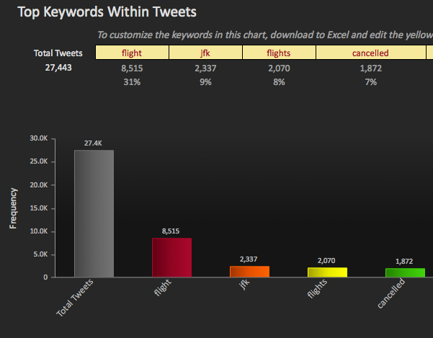
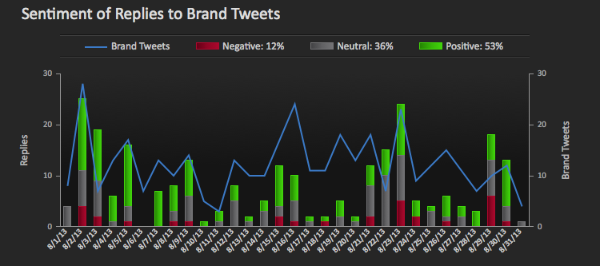

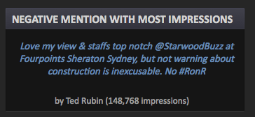

Pocket – Content Discovery
AlchemyAPI Use Cases
What it is:
ROI
AlchemyAPIs Used
Monitor social media to help clients understand their customers’ needs
Who should we engage?
What do our followers care about?
What content and promos should we offer?
Results
Real-time trending of topics followers care about
Increased engagement by targeting content and offers relevant to users’ interests
Concept Extraction
Entity Extraction
Additional Notes
SM’s Custom ETL
SM’s HBase
Alchemy processes > 3M tweets/day

Slide 28

TABElog – Retail
AlchemyAPI Use Cases
What it is:
ROI
AlchemyAPIs Used
Challenge: finding images that help foodies virtually experience restaurants
Serving up accurate restaurant reviews with Image analysis
Combines food reviews, photos and guest blogs with AlchemyAPI’s computer vision services to enable foodies to discover the best dining experiences across the US.
Analyzes: 1,000+ photos / day, 40,000 users interacting with site daily, 100,000+ registered restaurants
Types: images and photos
Solution: Image Analysis REST API that finds the best images to represent a restaurant
Reduces the amount of time needed for the mundane, repetitive task of separating useful images from mountains of unrelated or inappropriate content.
Value: increased productivity, dramatic time savings, desired results
Results: Tabelog.us (“specialized social networking site”), viral adoption by restaurants and users, rapid application and site development
Image Analysis
Additional Notes
Why the Image Analysis API?
“As an experienced developer, one of the first things that impressed me was how quickly I implemented the Image Analysis API.”
“It only took an hour to get a custom library built and working with it.” “The simplicity of the REST API makes it language agnostic and gives us the cross-domain integration we need.”
Other factors: performance based– competitive services did not reliably filter images like they wanted.

Slide 29

Pulsar – Marketing
AlchemyAPI Use Cases
What it is:
ROI
AlchemyAPIs Used
Challenge: going beyond metrics to reach insight because ineffective in collecting and interpreting streams of social data
Helping brands understand customers with social media intelligence
Analyzes: 20-30 million documents/ month
Types: Unstructured data across social platforms
Social intelligence platform
Integrates AlchemyAPI’s services in every product on social media monitoring platform
Tailors outputs to meet clients’ specific objectives through data surfacing
Better understand what customers want in products and demand in their experiences
Value: easy-to-integrate NLP capabilities enable rapid monetization
Result: superior social data intelligence, accelerated R&D at significantly lower cost, expanded product lines and innovation of social media intelligence products, optimizing social channel
Language Detection
Keyword Extraction
Sentiment Analysis
Additional Notes
Social Panels (newest development): designed to listen to the online conversations of specific audiences
Ability to apply metadata that distinguishes relevant versus irrelevant content
Designate an audience and listen to everything that group publically discusses through all social channels
On R&D savings:
“AlchemyAPI’s services do a lot of the legwork, allowing us to slice, dice and structure the data so that our clients can understand their audience and differentiate based on what they learn from the conversations happening around them”

Slide 30

Waggener Edstrom – Public Relations
AlchemyAPI Use Cases
What it is:
ROI
AlchemyAPIs Used
Challenge: Analyzing real-time data to determine if the content is relevant to a specific customer (website content, social media, news coverage)
Enabling agile PR strategies by gathering intelligence and identifying trends
Analyzes: 1.5 million tweets/ day, 2.5 million posts/ day
Types: Website content, social media, news coverage
Data mining and analytics platform (WE Infinity) that identifies trends and discovers competitive intelligence showing where and how performance improvements can be made
WE Infinity – Near real-time analysis using 5 AlchemyAPI services
WE Infinity: real-time data mining and analytics platform, 80% automation, real-time communication and performance analytics
Value: data-driven decisions create a bigger bang for every campaign dollar
Result: prototype app developed in one week, WE infinity (real-time data mining and analytics platform)
Keyword Extraction
Concept Tagging
Named Entities
Author Extraction
Text Extraction
Additional Notes
5 APIs used:
Keyword Extraction: finds and ranks specific keywords in page content and index.html
Concept Tagging: enables abstraction, understanding how concepts relate, and tags accordingly
Entity Extraction: identifies people, companies, organizations, cities, geographic features and other entities from HTML, text or web-based content
Author Extraction: identifies the source for news articles and blob posts
Text Extraction: retrieves the text from web pages and strips the ‘chrome’ while allowing return of embedded links; Infinity also extracts content titles using Text Extraction
Analysis services are ‘turned on and off as is appropriate’
Content is processes through AlchemyAPI REST services and then sent to an editing application that matches articles and discussions to concepts that WE’s account teams and clients want to further review

Slide 31

CEBRA – Public Health and Safety
AlchemyAPI Use Cases
What it is:
ROI
AlchemyAPIs Used
Challenge: real-time discovery, sharing of biosecurity information
Identifying and sharing data on infections requires daily Google queries and rigorous monitoring for mentions of tainted products/ outbreaks in RSS feeds, search engines, industry journals and Twitter
Analyzes: 6,000 unique text items/day
Types: text
International Biosecurity Intelligence System (IBIS)
Web 2.0 intelligence network for plant and animal biosecurity devoted to collecting and organizing information used to track and forecast diseases/ follow emerging diseases
Solution: AlchemyAPI’s text extraction, language detection and named entity extraction
Value: excellent situational awareness and competitive edge
Results: 206 RSS feeds monitored/day, 283 separate Google queries/ day, real-time information collection and archiving, reliable resource for proactive disease control, increase automation
Named Entity Extraction
Text Extraction
Language Detection
Additional Notes
Top 20 results for each query and any new URLs are added to the results queue for processes. Processing is executed by calling:
URLGetAuthor
URLGetLanguage
URLGetRankedNamedEntities
URLGetRawText
URLGetText
URLGetTitle
Each processed article becomes a new ‘node’ in IBIS database
Node includes original title and text, then translated title and text, the author and the location
Geonames are used to convert place names found by AlchemyAPI into lat/long coordinates

